Slide 1

Team Name: Stellar Matrix
Name of College(s)/University(s): IISc, Bengaluru ; NIT, Tiruchirappalli
Team Members:
Abhimanyu Ambikapathy, IISc Bengaluru
Rolla Siddharth Reddy, IISc Bengaluru
Vaaruna Ramakrishnan, NIT Tiruchirappalli

Slide 2
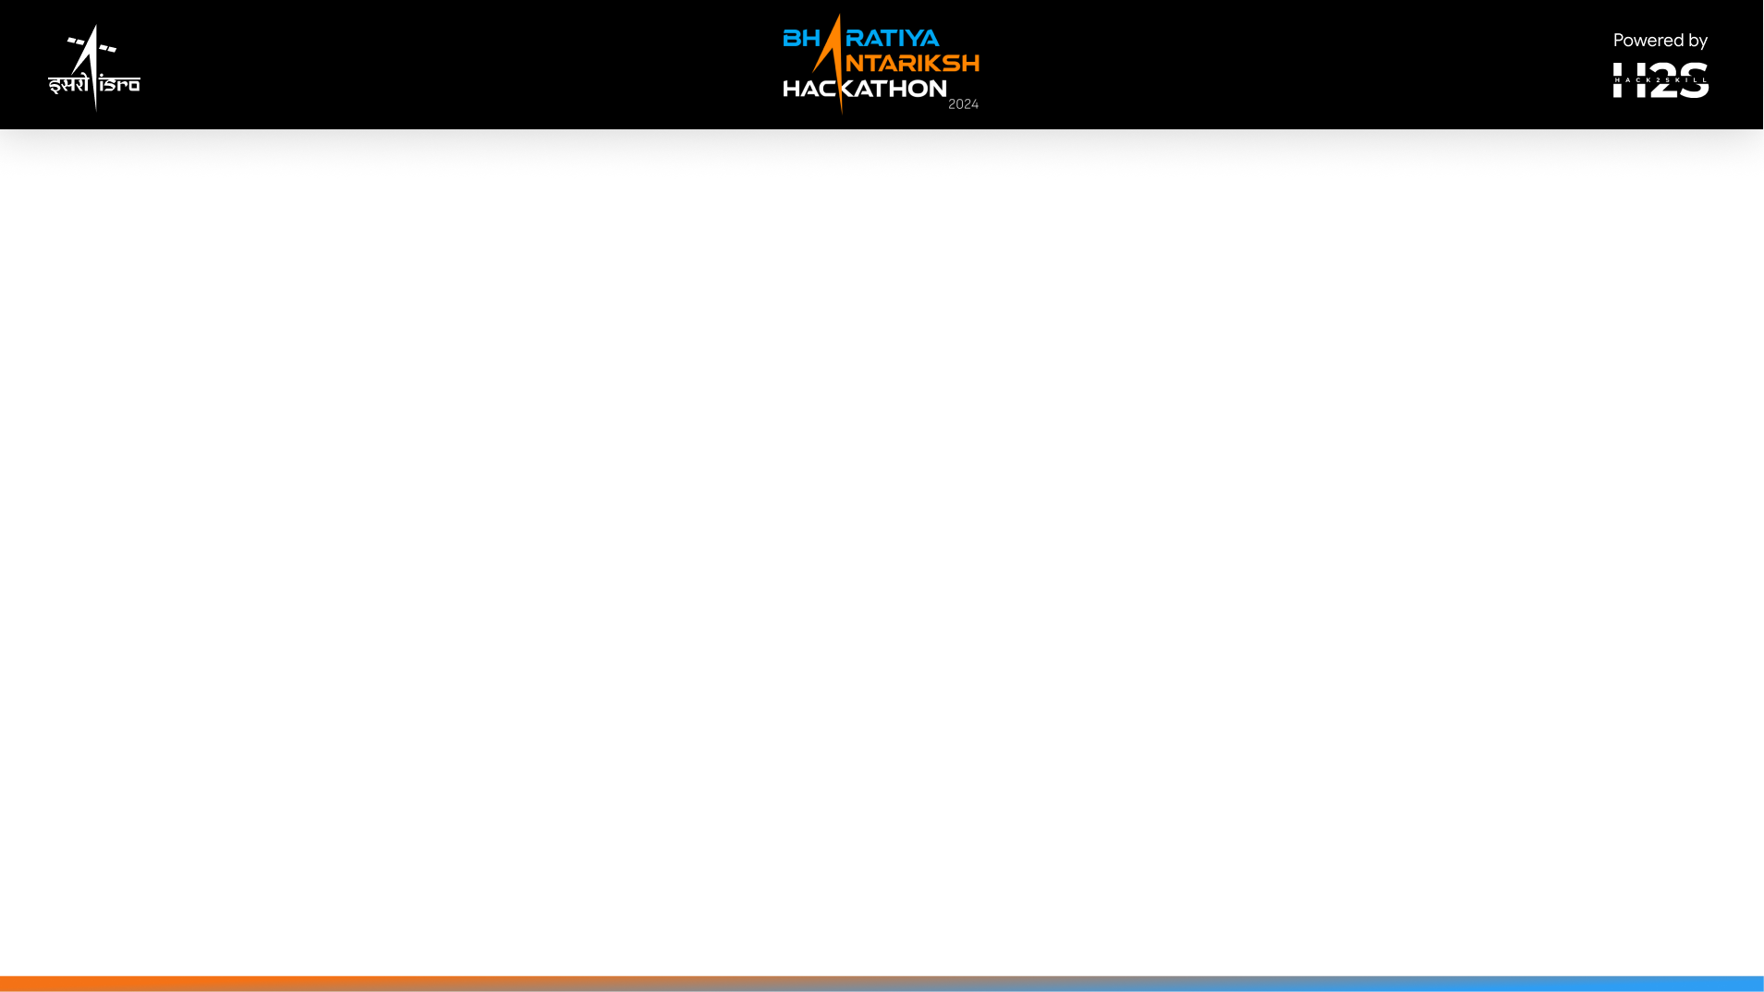
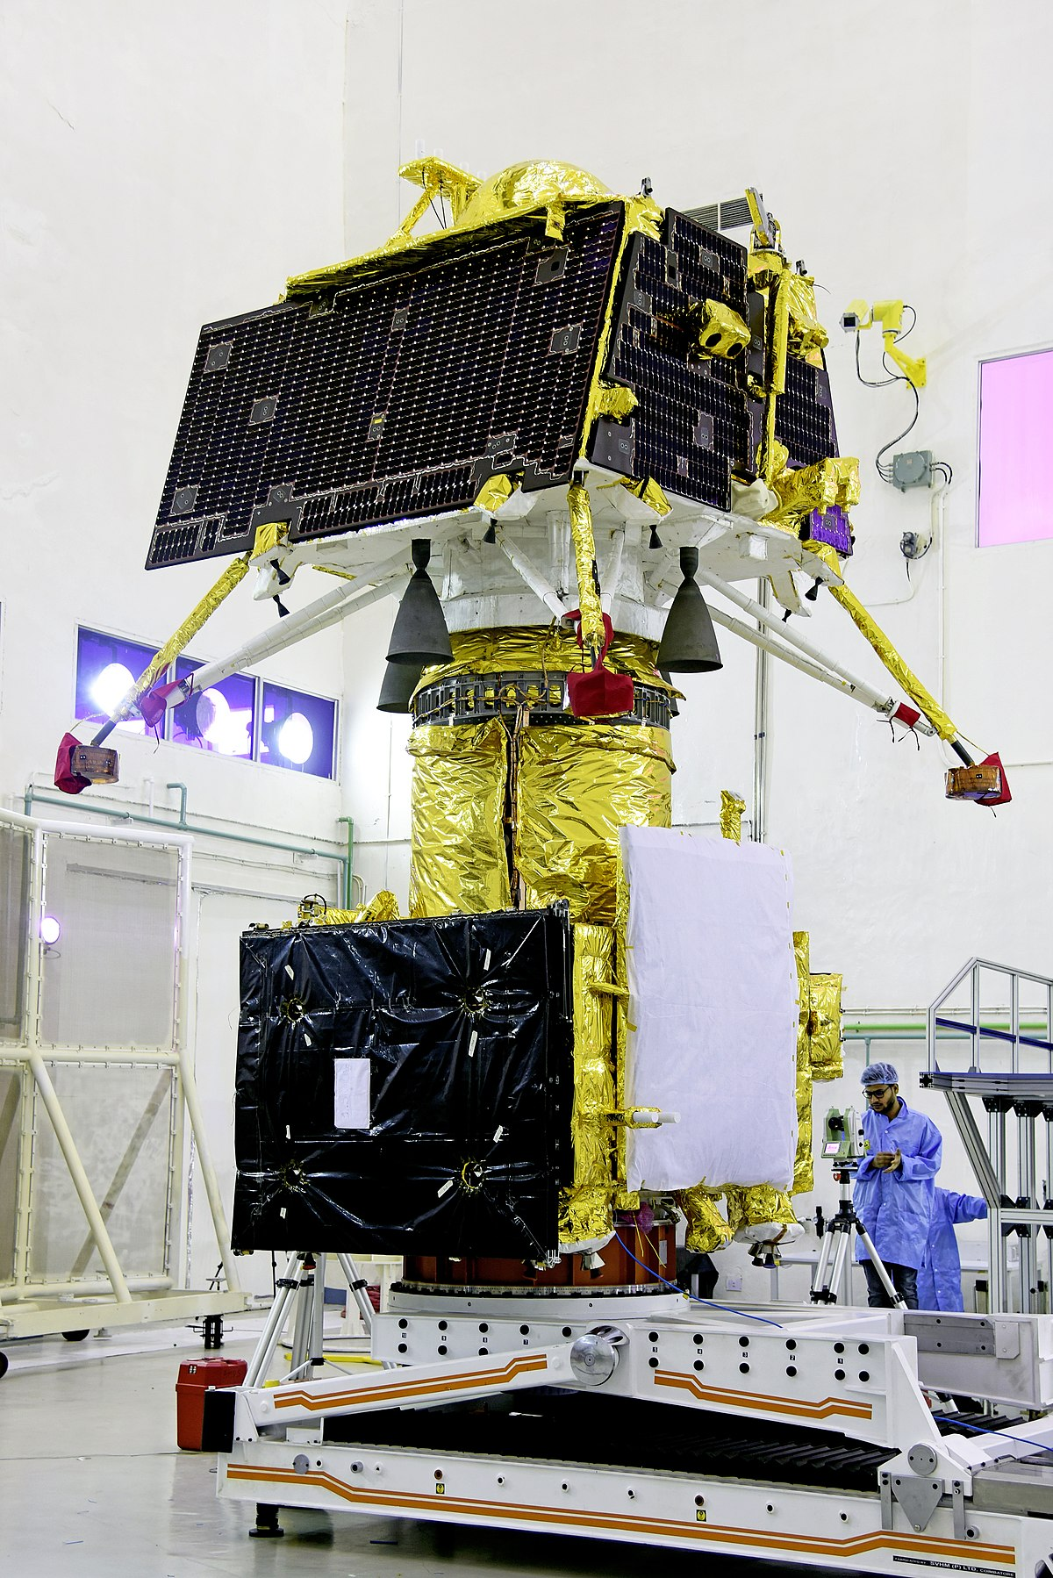
A Brief Introduction to the Problem Statement and the Idea
The process of finding a safe navigation route for Pragyan, the Chandrayaan 2 rover is an important task for exploration of scientifically important sites in the lunar surface, evaluating several aspects and in a way, could help other missions for good landing site candidates, satellites for focusing on a particular area of interest.
Even though the original mission in 2019 was a partial success, with the landing module experiencing a hard landing and subsequent loss of communication with the rover, this gave us an opportunity to devise ways for carrying out the mission in ways like manual route making and automation of the same, for the rover, in a possibility of it functioning.
Source : Wikipedia

Slide 3
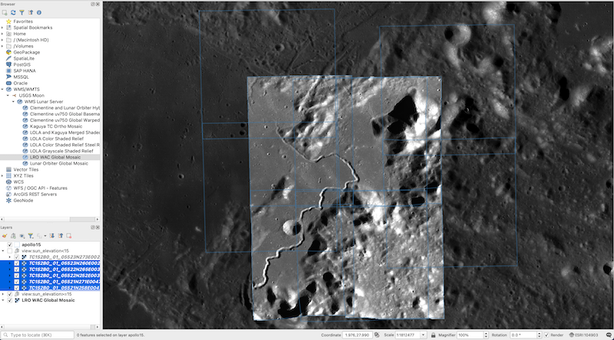
Our Idea/Approach:
We have pursued two methods of finding the safest navigation route, ensuring that it is the most optimised one. These are :
Manual route-making, using software like QGIS on existing satellite data
Automated route finding, using Python code and user-entered data points to get the most optimised result
I. Manual Route Making
In this way, satellite data, which includes raw and processed images of certain areas, in our case, the lunar South Pole Region is taken and using software like ArcMap, QGIS etc. routes can be made. However, this requires a good handle of knowledge on using software like these, along with significant time spent on manually crafting the points for the route.
Representative Image ; Source : USGS

Slide 4
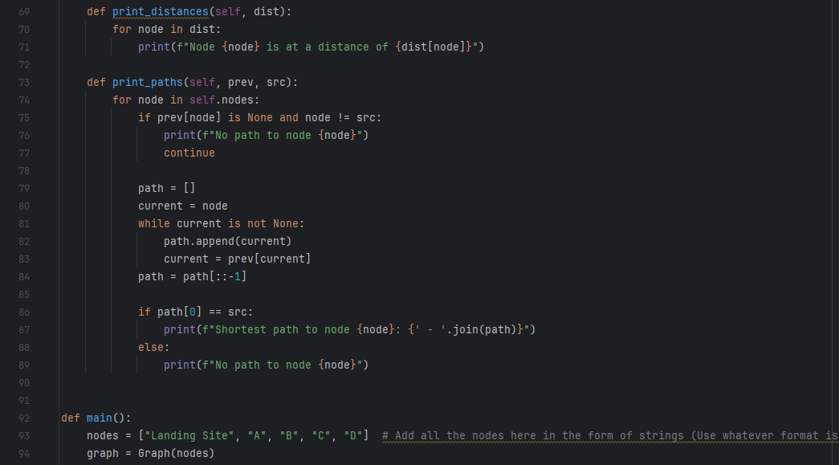
II. Automated Route Finding
The most Efficient path is analyzed in the following way:
A digraph is created between nearly every pair of important points on the map, labeled as nodes.
Edges are constructed using a computable formula that accounts for intermediate characteristics of the actual path.
Distances between node pairs are calculated using the moon's curvature and node coordinates.
A modified Dijkstra's algorithm determines the shortest path from the source to every other point. Paths to nodes at least 100m from the starting node are analyzed.
This automated process identifies various possible paths for the rover, considering its dimensions and properties.
A small snippet of the code used in our solution

Slide 5
Tools, Technology and Data Sources Used:
QGIS Desktop 3.34.8
PDS4 Viewer for using XML files
Chandrayaan-2 Data, used from ISSDC
Maps made from LRO data, accessed from the website of Lunar and Planetary Institute, USRA
Virtual Moon Atlas software (AtLun 8.2 version)
Python programming language for creating the code
Research papers and articles for finding sites of interest and route
These sources ( excluding the software part) can be found in our GitHub Repository:
https://github.com/Starmanbw95/Stellar-Matrix-BAH-2024

Slide 6
Workflow Map for both parts:
Manual Route Making
Automated Route Finder
Satellite Data (High-Res)
(ISSDC CH-2 used in this case)
Use QGIS, ArcMap to create the route by marking the points
Route is Obtained
Run the code
Enter desired site(s) co-ordinates as nodes
Best route is obtained without need for downloading loads of High-Res. Data

Slide 7
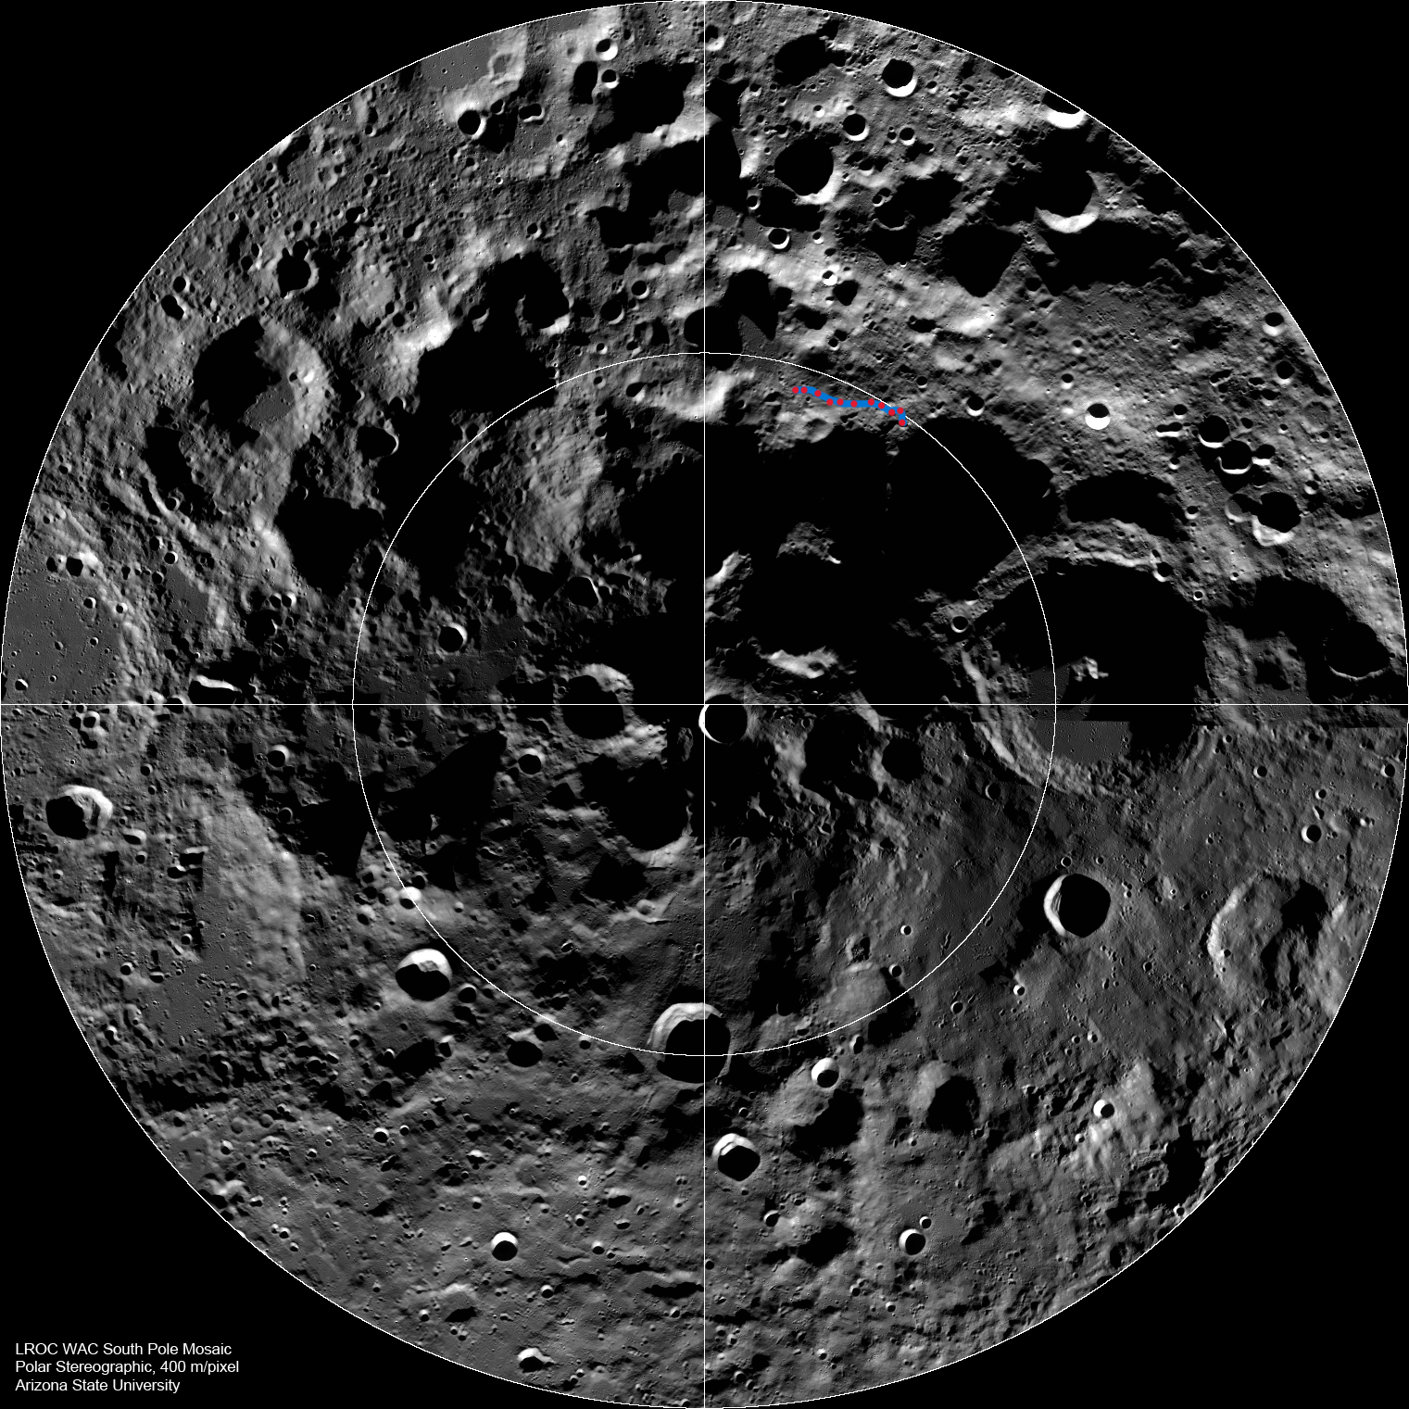
Solution Brief
Our primary approach to this problem statement is to investigate both ways of generating a route, the manual and automated way. The code does consider aspects required for making this route, which are Terrain Slope, Presence of Permanently Shadowed Regions, Boulder and Rock concentration etc. With more versions in the future, we can bring more crucial parameters into consideration and make more refined routes.
What proved to be pivotal in the research area of this idea was the involvement of data of various missions, which include:
Chandrayaan – 2, ISRO
Lunar Reconnaissance Orbiter, NASA
The Artemis Program Data, NASA
The Chang’e Missions, CNSA
and more…
The Artemis Program, even though it hasn’t fully been completed, did provide us locations to scout for, as the potential landing site candidates for the future missions in their program are exploration-worthy sites with abundant research opportunities.
One of our earlier Draft Routes with the path in focus
Source : LRO, NASA

Slide 8
Solution Brief
As for the Manual part, we had to make comparative studies of regions from latitude of 80ºS to the Pole, at the rim of Shackleton crater. Some of the observations which we had made, based on existing studies and papers, during finding of the scientifically important stops for exploration in the route include:
Crater Rims with lesser inclines
Connecting Ridges between Craters (Ex: Shackleton, Sverdrup, de Gerlache)
Areas with less boulder concentrations calculated by nearest crater impact activity
Non PSR sites as the rover is Solar powered
Paths with incline of less than 15º ; the rover has a maximum climb limit of 20º
Software usage experience is, however, a pre-requisite for this method, which might seem detrimental as compared to the automation way where one can just enter nodes based on the Selenographic Co-ordinate System.
Early efforts to look for good exploration sites
Source : CH – 2 TMC Data

Slide 9
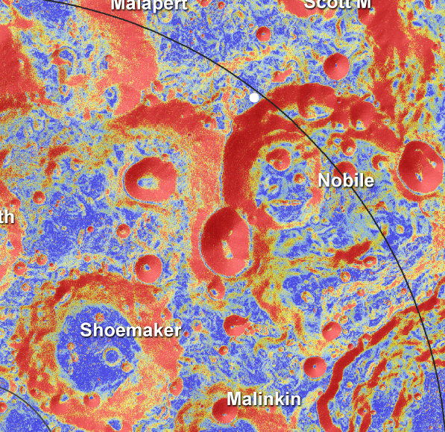
Conclusion
The overall aim of this problem statement, the finding of a safe navigation route for the Pragyan rover, can be achieved by several ways. We have used two of them to achieve it. But there can be more, and in the future, with more advancements in technology and possibly more collaborations between space agencies, extensive study of the Moon, especially the South Polar region, can be carried out.
Now that Chandrayaan 3 has landed there and with more Chang’e missions and the entire Artemis Program, More data collection and analysis can certainly lead to a better understanding of our natural satellite.
An approximate location of the Chandrayaan 2 landing site, in the LRO slope map
(Source : LPI)

Slide 10


